Slide 1
GRETA GERWIG
Year 11 Media Unit 2 Outcome 1 Narrative, Style and Genre

Slide 2
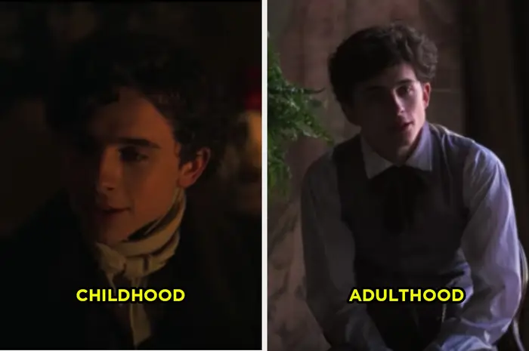
Codes and Convetions
Gerwig manipulates media codes and conventions to create distinctive narratives.
For instance, she uses different color temperatures to distinguish the past from the present
Gerwig's use of match cuts and match scenes in 'Lady Bird' and 'Little Women' creates a visual continuity that enhances the narrative flow.
Her use of differing camera techniques and editing styles also contributes to the unique visual language of her films.

Slide 3
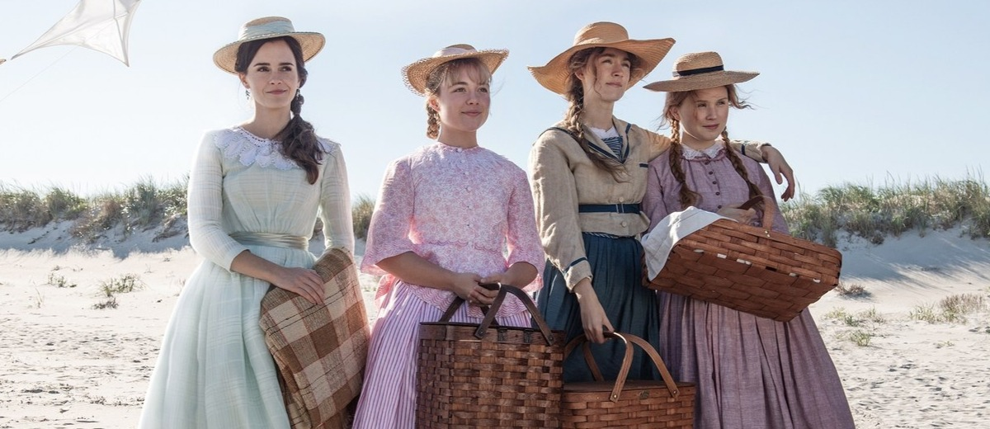
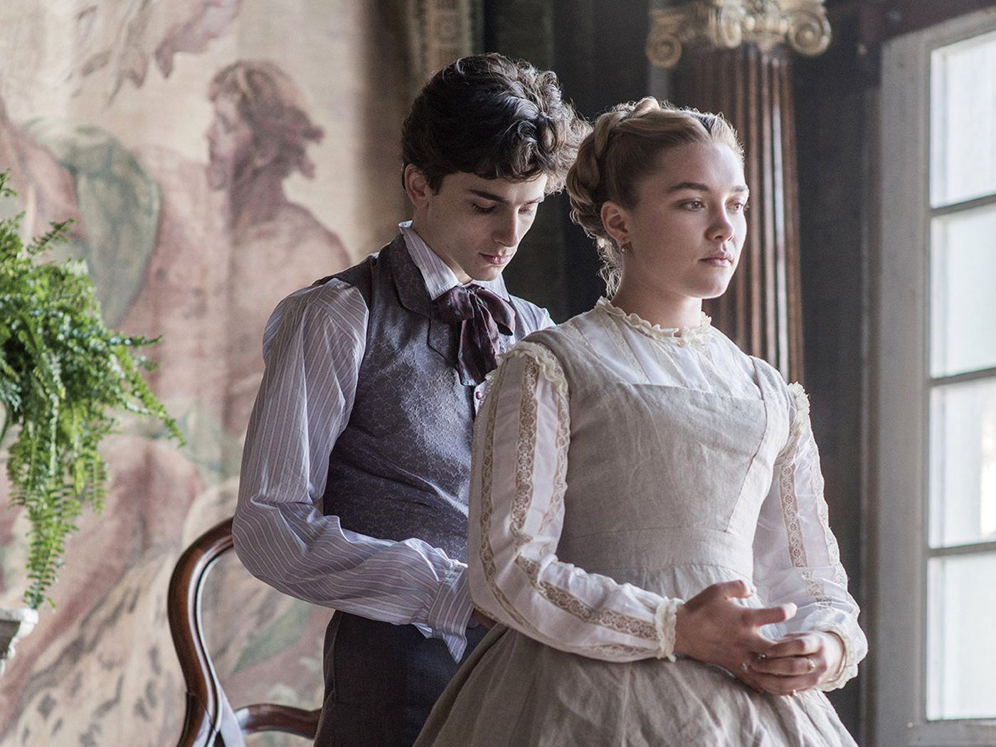
Camera
Gerwig's use of the camera is instrumental in telling her stories.
In terms of cinematography styles, Gerwig tends to favour a decidedly “unshowy” look, most shots are still and well-framed and still, meaning that the audience doesn’t actively focus on the visual artistry of the camera, but more on the characters and the dialogue.
In Little Women, the visual style is a little more noticeable. The cinematographer Yorick Le Saux explained that with this film, it was shot in 35 mm to give it a bit of graininess and texture. In the sequences showing the girls as children, Le Saux used imprecise long, wide shorts with a moving camera to show the family as a unit. In the later sequences, the shots are more still, with each character getting their own shot. This was intended to show the discrepancy between their togetherness as children, and their more separate adulthood.
Le Saux went on to explain that Gerwig tended to focus on the actors during the shoot, and let him get on with organising shots and lighting. Because Gerwig comes from an acting background, it’s easy to see why she gravitates towards her actors on set.

Slide 4
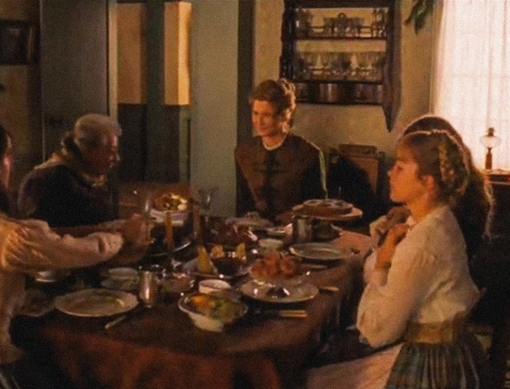
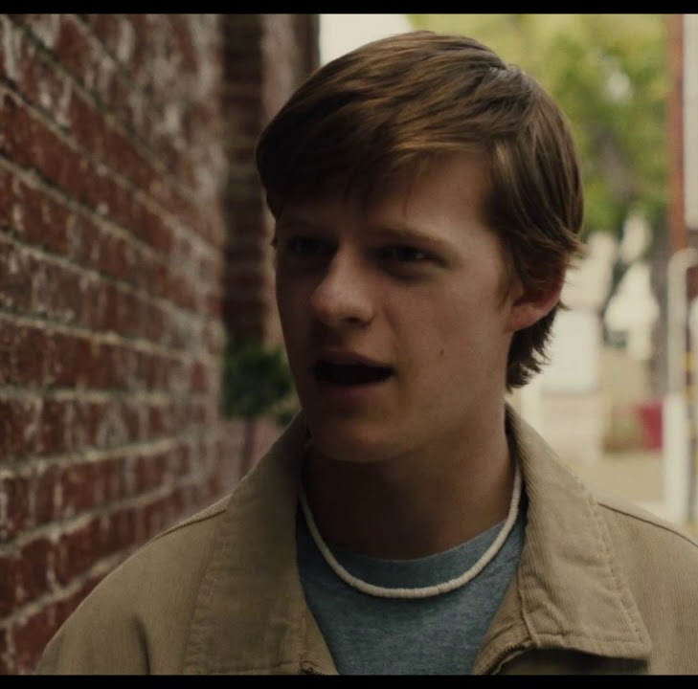
Acting
The performances in Gerwig's films are deeply authentic and emotionally resonant.
Apparently, Gerwig encourages her actors to make the characters their own by incorporating elements of their personalities into the performance.
When it comes to character dialogue, Gerwig is determined to present characters that speak like real people.
In order to understand how people speak in the real world, Gerwig often transcribes strangers’ conversations. People don’t speak in full sentences, so this technique has allowed Gerwig to get a better grasp of how humans express thoughts through words — hence hyper incredibly unique, hard-hitting scripts.
In Lady Bird, the rhythm is quick, most humour comes from the way characters undercut and interrupt each other. In other words, characters in Gerwig films don’t wait patiently for the other character to complete their thought.
This technique is utilised with great effect in Little Women. In fact, the cast apparently spent weeks rehearsing scenes in order to confidentially interrupt each other during filming. This creates a decidedly authentic version of reality, where family members all speak at once, and characters form thoughts and sentences that naturally cut into other lines.

Slide 5
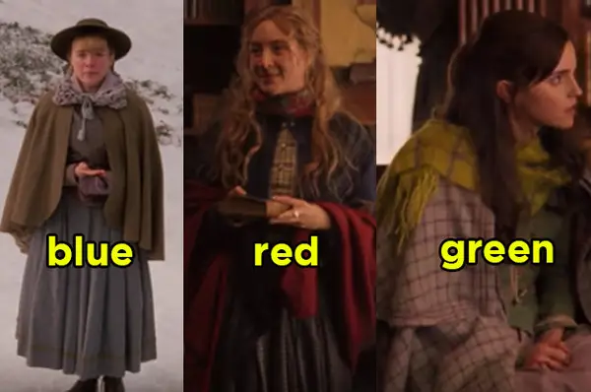
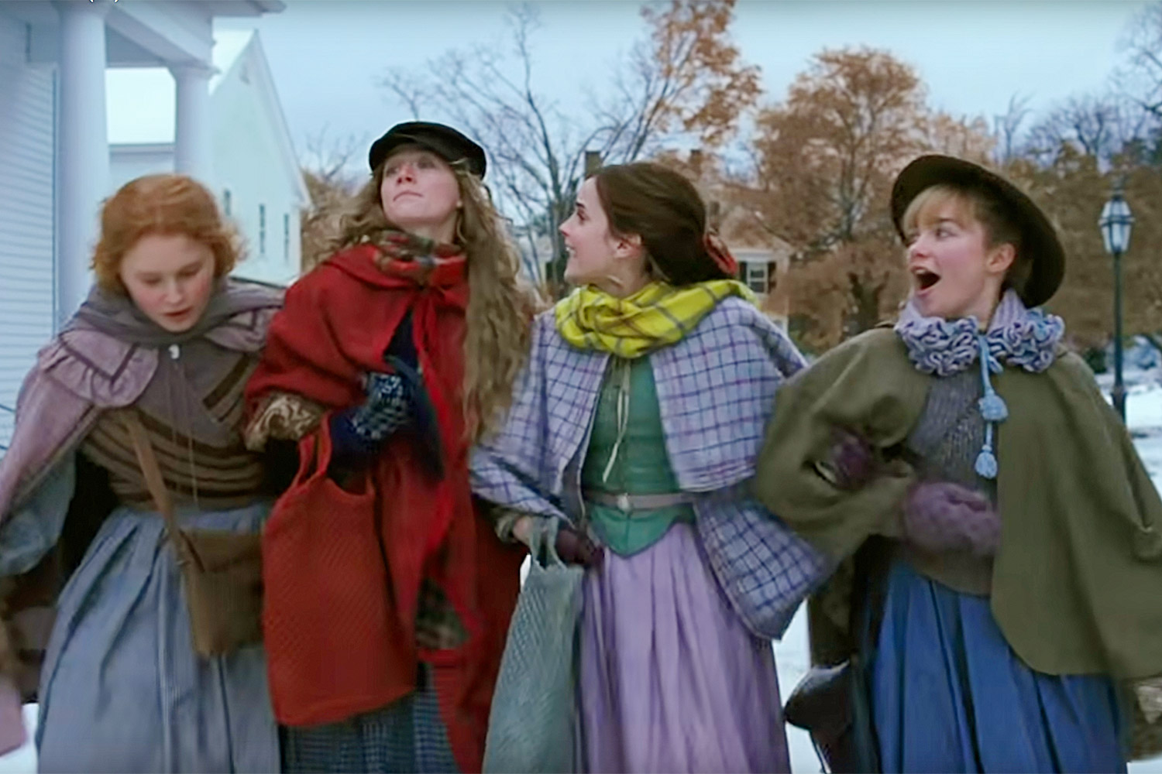
Mise-en-scene
Gerwig's mise-en-scene, or the arrangement of everything that appears in the frame, contributes to the mood and meaning of her films.
She pays careful attention to elements such as costumes, props, and set design.
For example, in 'Little Women', the costumes and sets help to recreate the historical period and reflect the characters' personalities and circumstances.

Slide 6
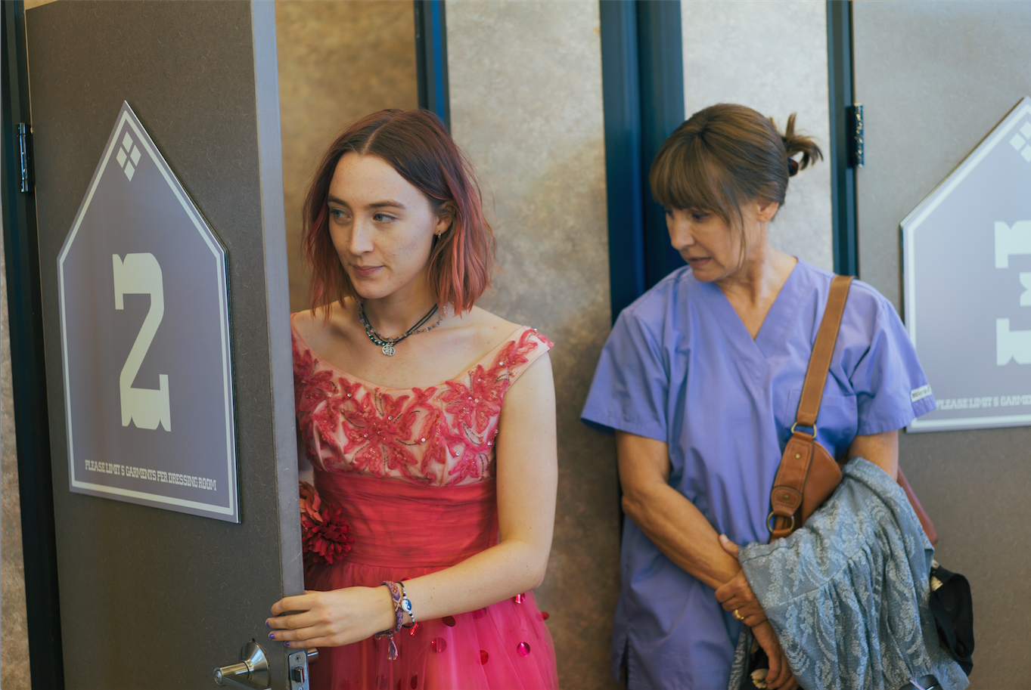
Editing
Gerwig's editing style is dynamic and fluid.
She uses techniques such as match cuts and cross-cutting to create visual and thematic connections between scenes.
Her editing also helps to control the pacing of her films and guide the audience's emotional response.

Slide 7
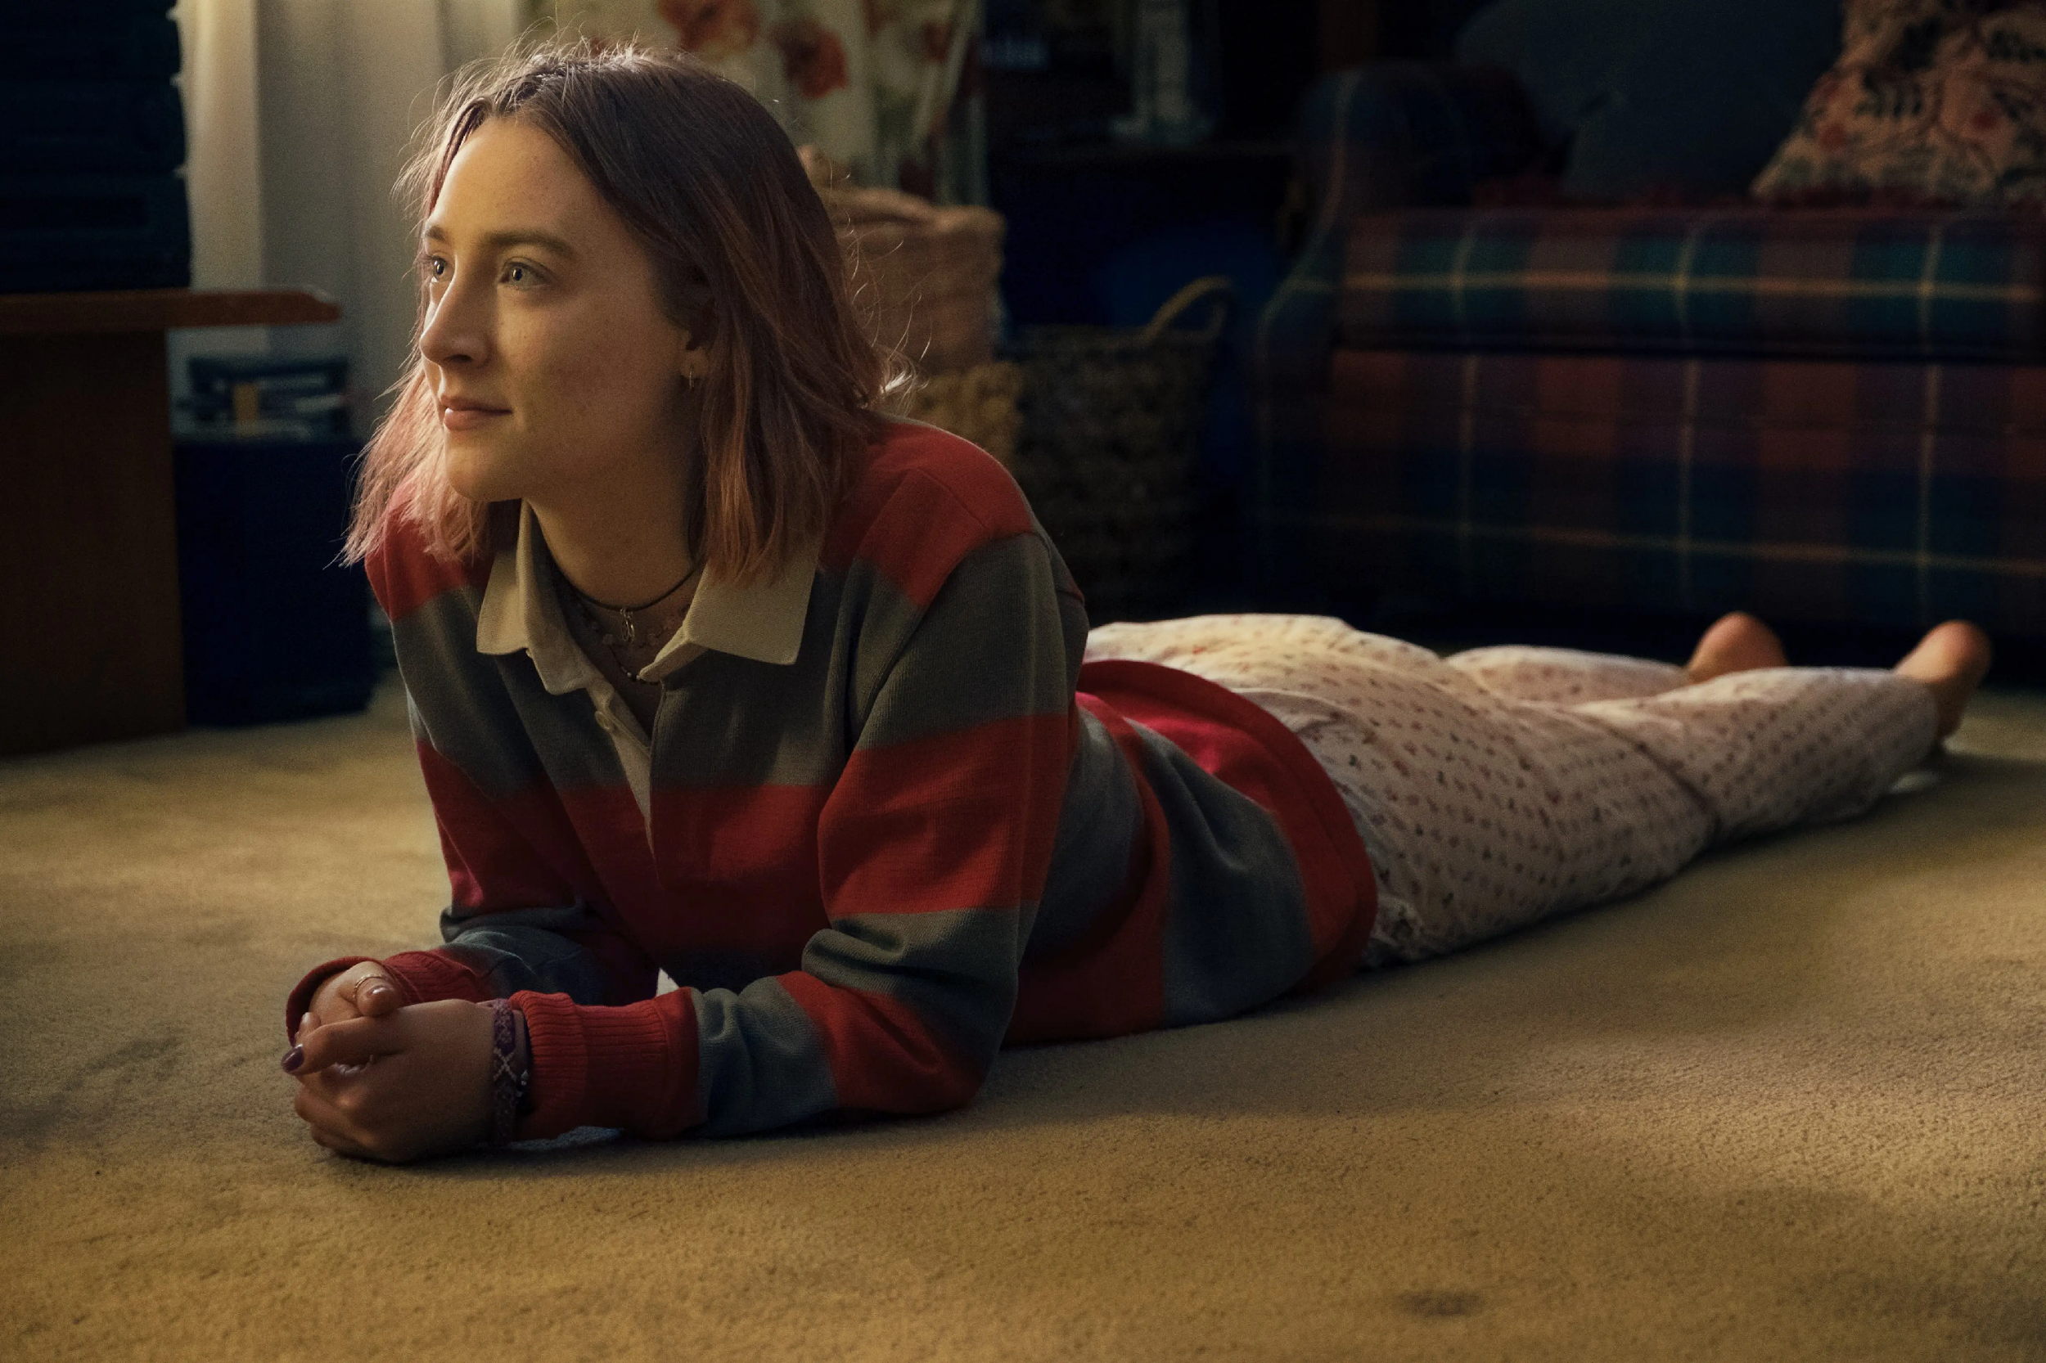
Lighting
Lighting plays a key role in Gerwig's films.
She uses different color temperatures to distinguish between past and present, and uses lighting to enhance the mood and atmosphere of her scenes.
For example, in 'Lady Bird', warm lighting is used to create a sense of nostalgia and intimacy.

Slide 8
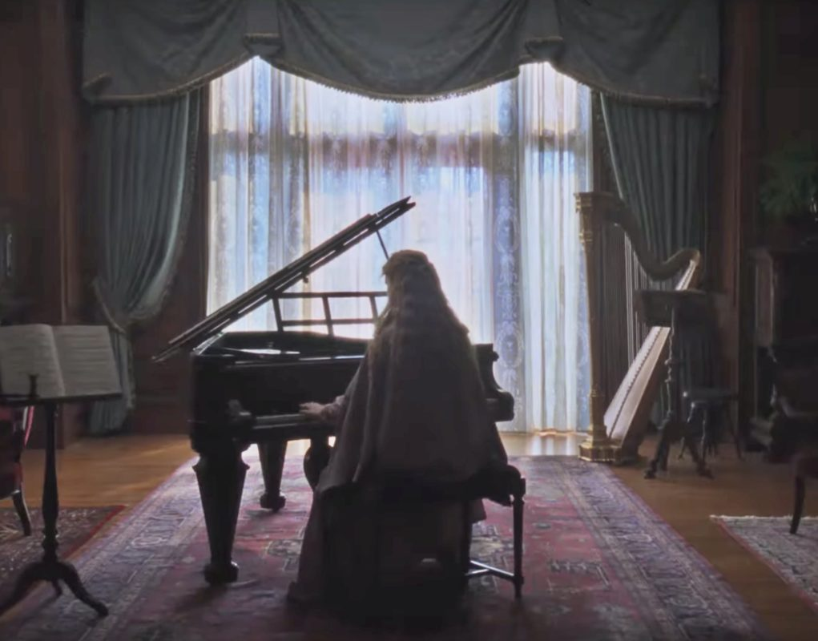
Sound
Sound is another important element in Gerwig's films.
She uses diegetic sound, such as dialogue and environmental sounds, to create a sense of realism.
She also uses non-diegetic sound, such as music and voice-over, to enhance the mood and convey the characters' inner thoughts and feelings.

Slide 9
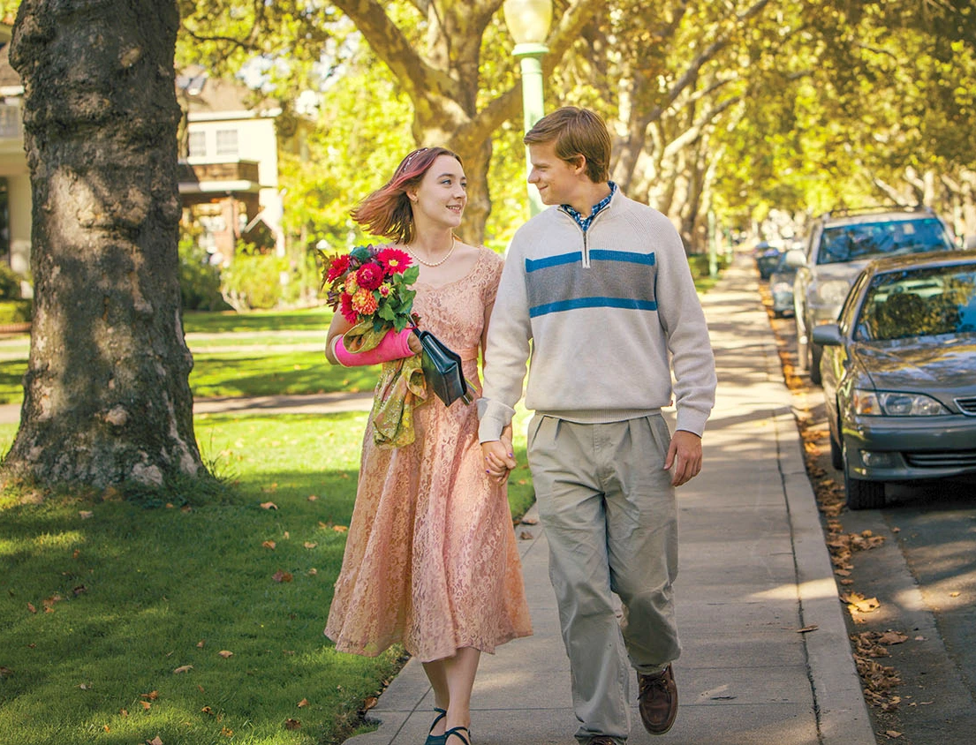
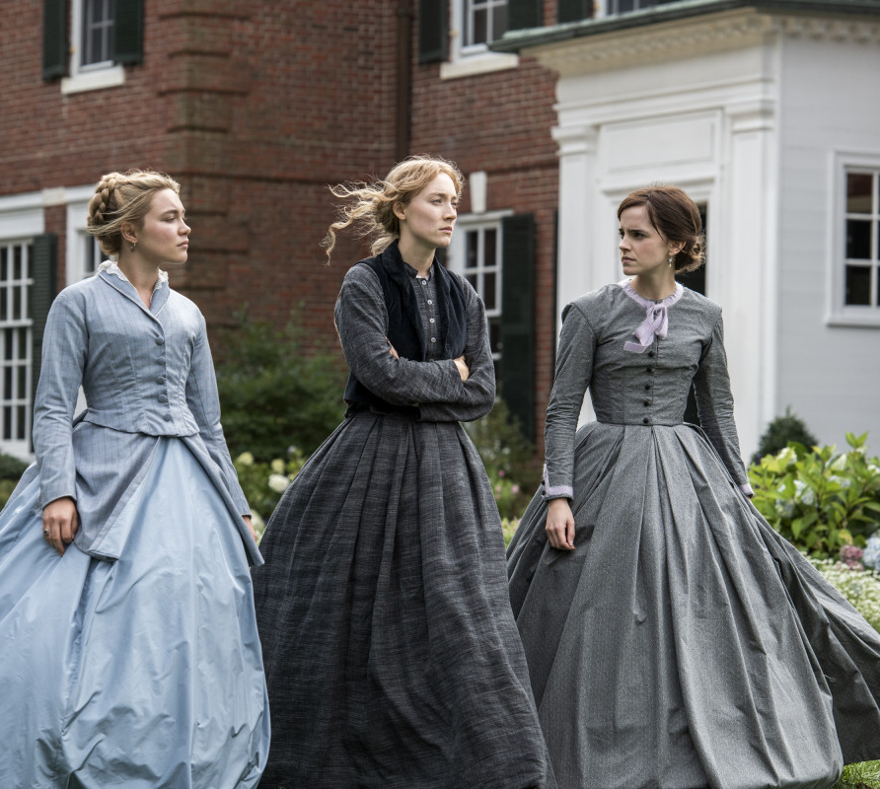
Historical and Cultural Contexts
Gerwig's narratives are influenced by historical and cultural contexts. For example, 'Lady Bird' reflects the experiences of a teenage girl growing up in the early 2000s
while 'Little Women' is set in the aftermath of the American Civil War and explores the limited opportunities for women during that time.
Gerwig's films also reflect the contemporary social issues and debates. Her portrayal of women's experiences and struggles resonates with the ongoing discussions about gender equality and women's rights.

Slide 10
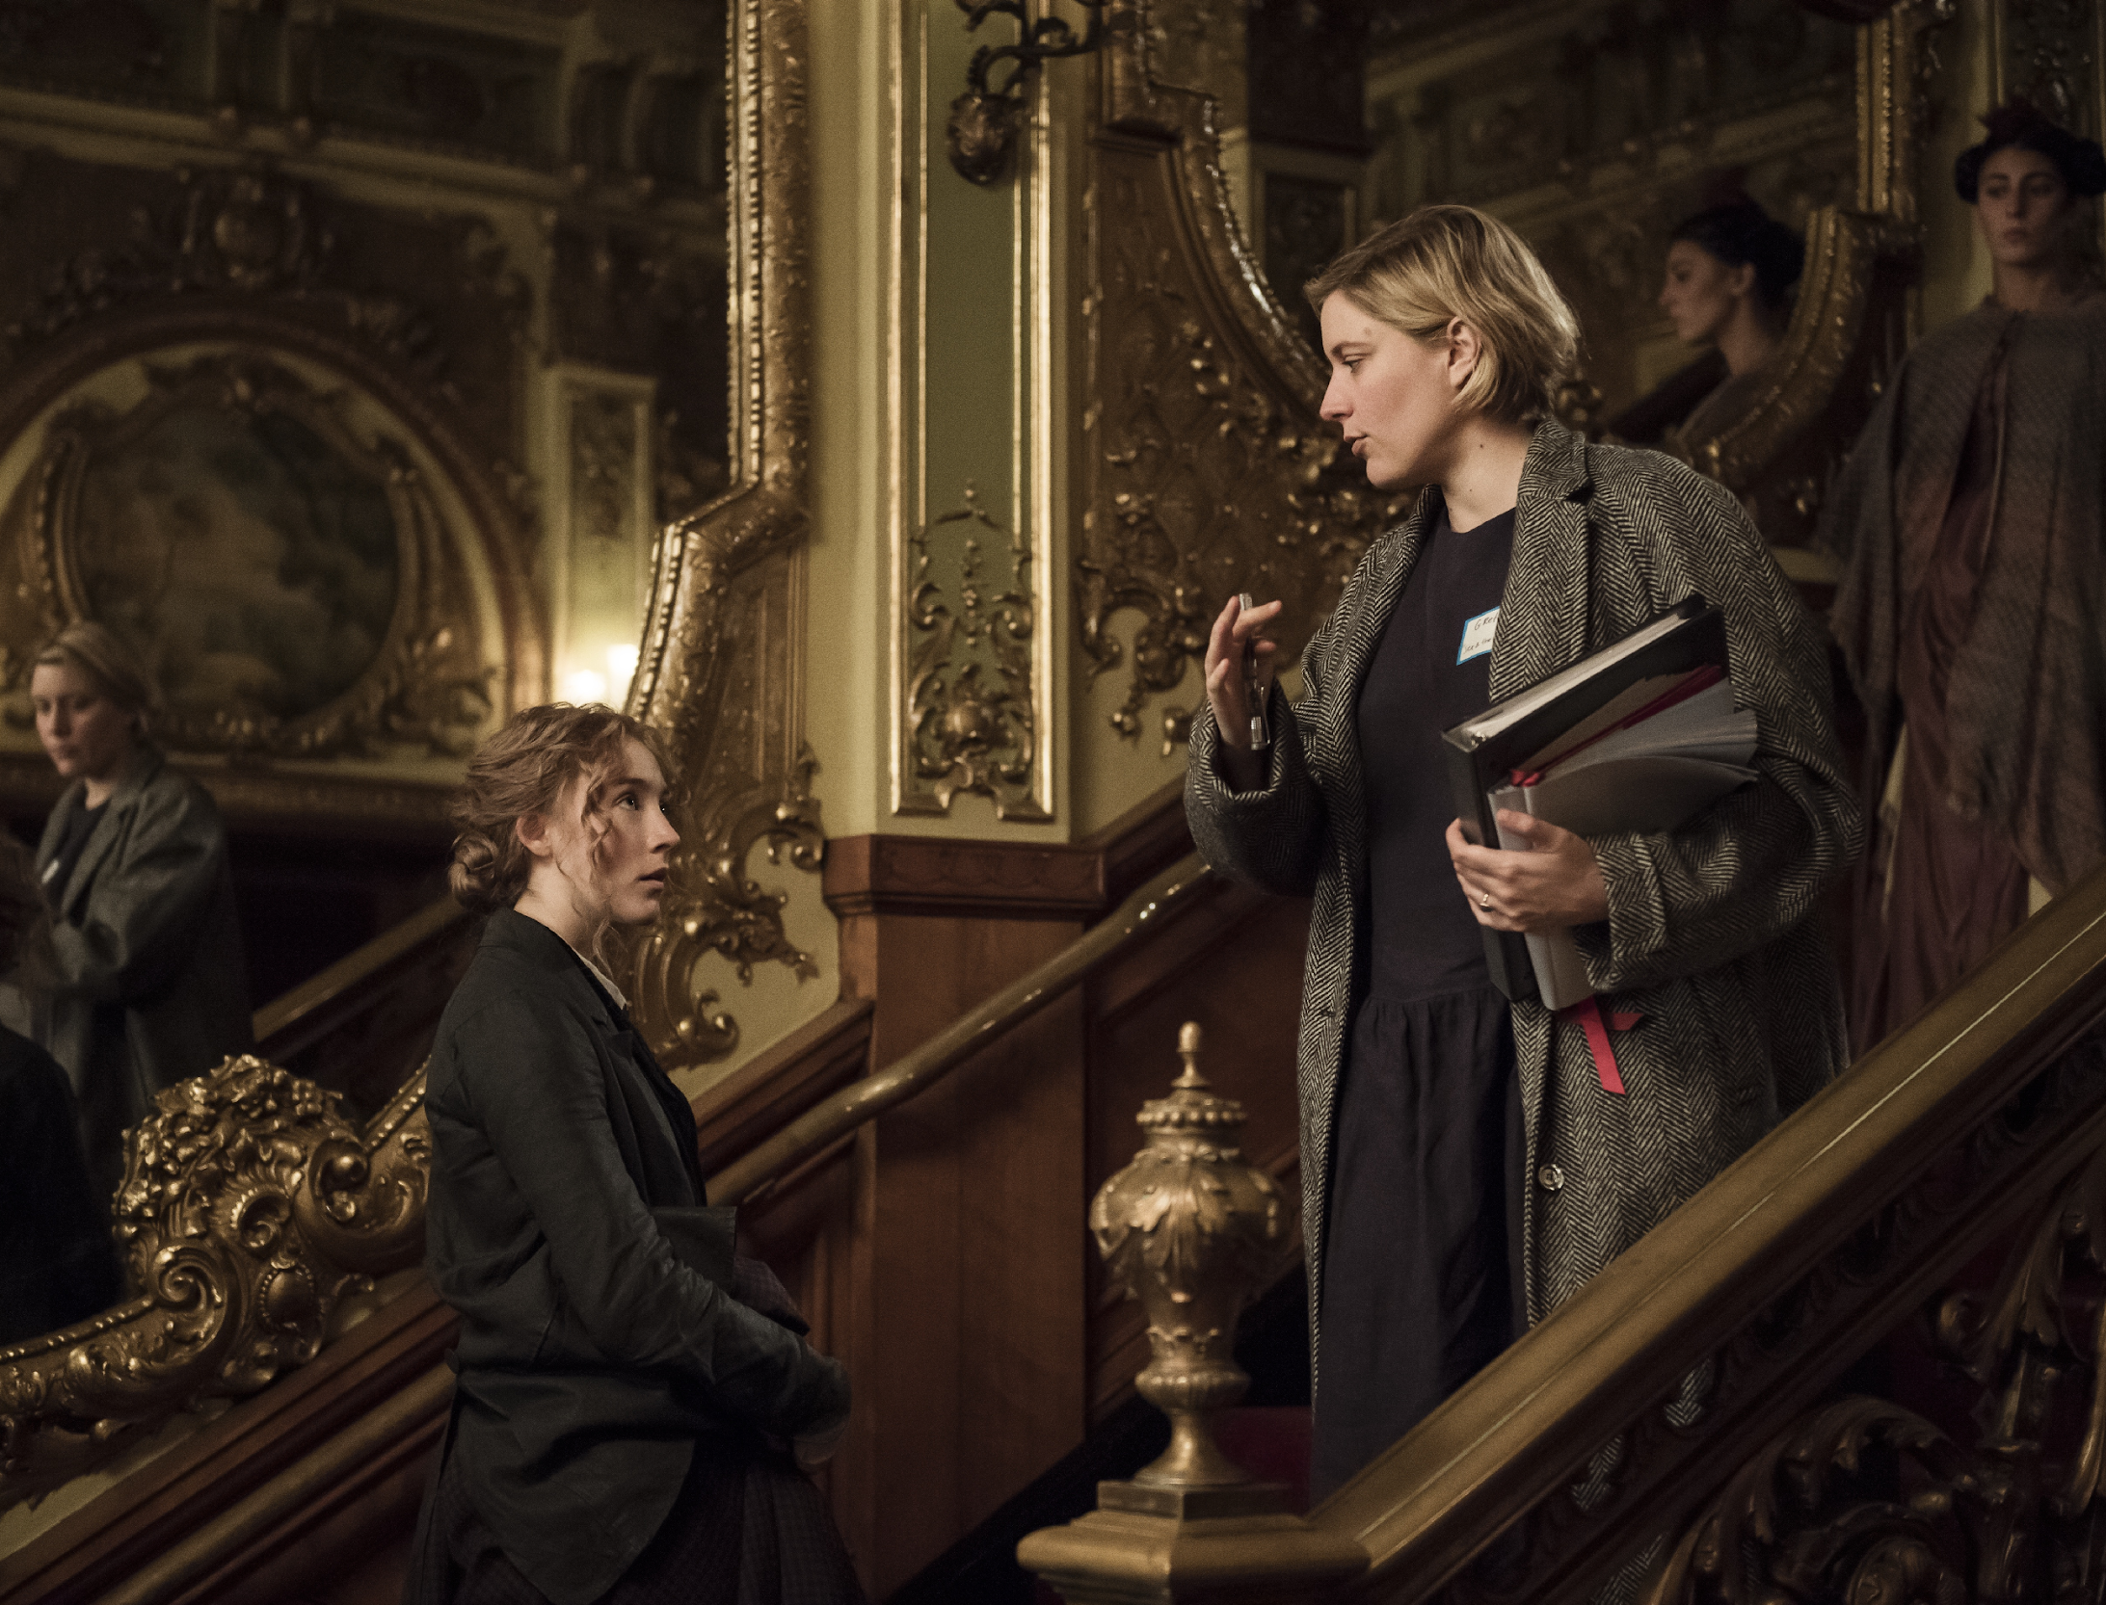
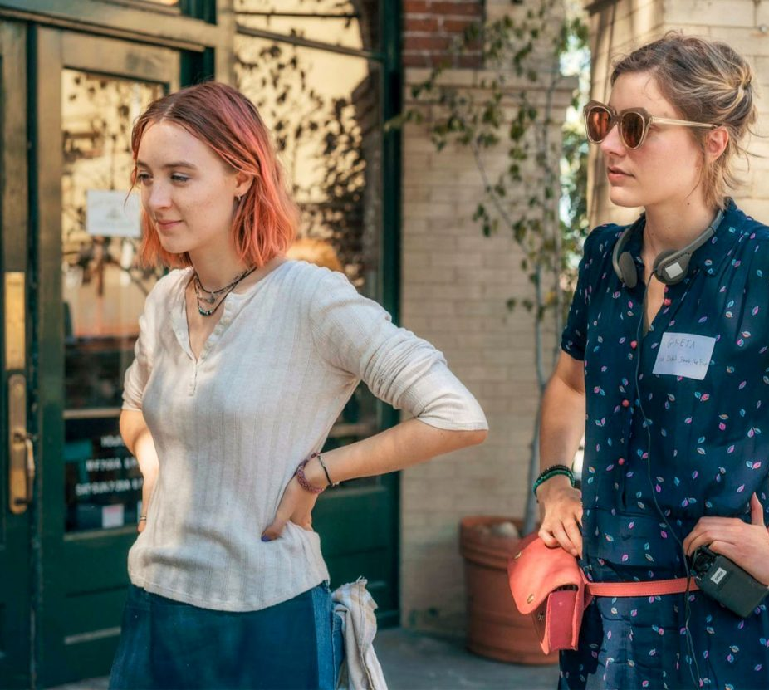
Genre
Greta Gerwig is often linked to the “mumblecore” genre. The genre was a movement of films that had low budgets, few production values, and almost always showcased the young, contemporary Americans on their journey to adulthood. These filmed have a DIY, indie feel, and often champion realism in terms of acting.
While Gerwig has certainly moved on from her early indie films onto much larger budget productions, some of the values remain, and the attention to realism, wit, and American youth remains in her newer films.
Gerwig uses and subverts genres to engage audiences. 'Lady Bird' is a coming-of-age drama that subverts the genre's conventions by focusing on the protagonist's relationship with her mother.
Little Women' is a period drama that challenges traditional representations of women in literature and film. Gerwig's reinterpretation of the classic novel gives a fresh perspective on the story and its characters.
Gerwig doesn’t tend to set her films in grandiose settings. Both Lady Bird and Little Women are set in domestic, family-oriented settings.

Slide 11
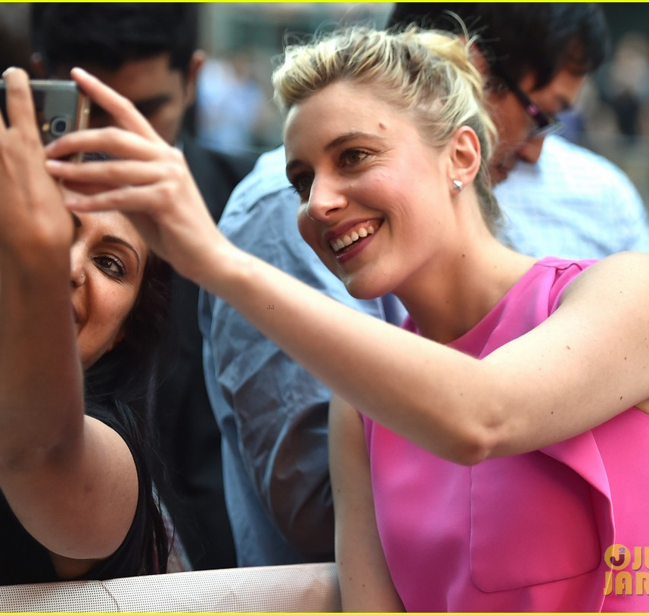
Audience Engagement
Gerwig's understanding of audiences and their engagement influences her narratives.
Her films resonate with audiences because they depict relatable experiences and emotions.
They have received critical acclaim and have been successful at the box office, demonstrating their wide appeal.
Gerwig's ability to connect with audiences is a testament to her skill as a storyteller and her understanding of human emotions and experiences.

Slide 12
Influence on Audiences
Gerwig's narratives influence audience engagement, consumption, and reception. Her films have inspired discussions about women's experiences and representation in media.
They have also influenced other filmmakers and have contributed to the increasing recognition of women directors in the film industry.
Gerwig's work has had a significant impact on the film industry and the way stories about women are told and received.
Gerwig's work has had a significant impact on the film industry. She has proven that films about women's experiences can be critically and commercially successful.
Despite facing challenges as a woman director in a male-dominated industry, Gerwig has paved the way for more diverse and inclusive narratives in cinema.

Slide 13
References
https://www.filmd.co.uk/articles/the-directing-and-writing-style-of-director-greta-gerwig/
https://www.nytimes.com/2017/11/01/magazine/greta-gerwigs-radical-confidence.html https://sites.psu.edu/healypassionblog/2021/09/17/greta-gerwig/ https://www.backstage.com/magazine/article/pointers-greta-gerwig-creating-movie-like-lady-bird-2026/ https://www.theedgesusu.co.uk/film/2020/04/12/director-in-focus-greta-gerwig/ https://www.hollywoodinsider.com/greta-gerwig-cinema-women/ https://mckeggcollins.medium.com/cinematic-seamstress-563f9f4a103b https://www.thecourieronline.co.uk/feminism-on-film-greta-gerwig-a-woman-director-in-the-male-dominated-industry/

